Slide 1
Demo annie
Week-02
01.12.2017

Slide 2
content
Concatenate string in a loop
Josephus Problem

Slide 3
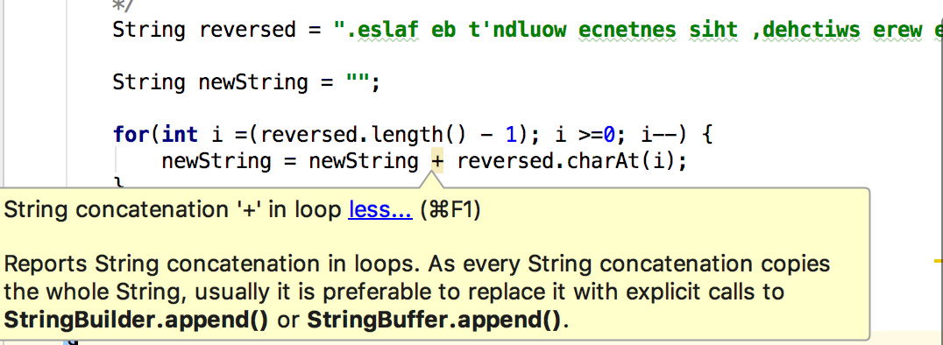
Concatenate string in loop
Idea:
Create a new empty string
Use ”for” loop, index from the end of the string to concatenate to new empty string
Return result = new string

Slide 4
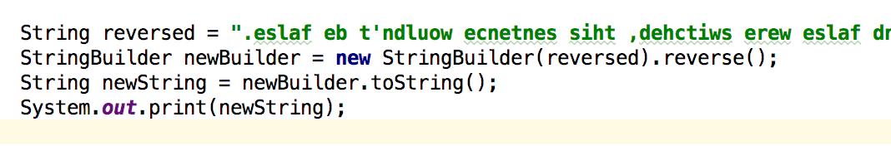
Problem with concatenation in a loop is:
create a new object every time step in a loop
=> Quickly add up to a lot of objects, almost all of which are completely unnecessary.
Care about performance => shouldn’t use concatenation in loop
SOLUTION:
-Use StringBuilder or StringBuilder: Basically same as String but they are mutable
- StringBuider is add later in Java5, similar to StringBuffer but slightly faster (not synchronized)

Slide 5
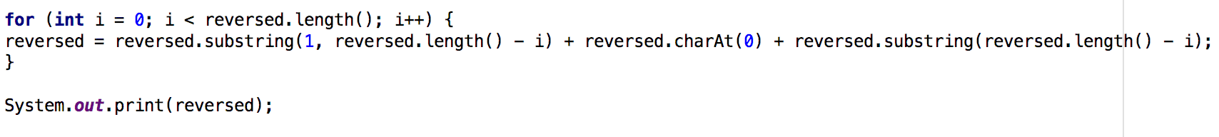
Use Substring:
i = 0 “nnie” + A
i = 1 “nie” + ”n” + “A”
i = 2 “ie” + “n” + “nA”
i = 3 “e” + ”i” “ nnA”
i = 4 “i” + ennA”
“Annie”
“nnieA”
“nienA”
“iennA”
“einnA”

Slide 6
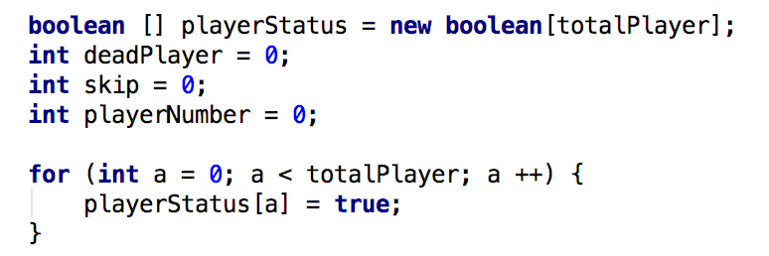
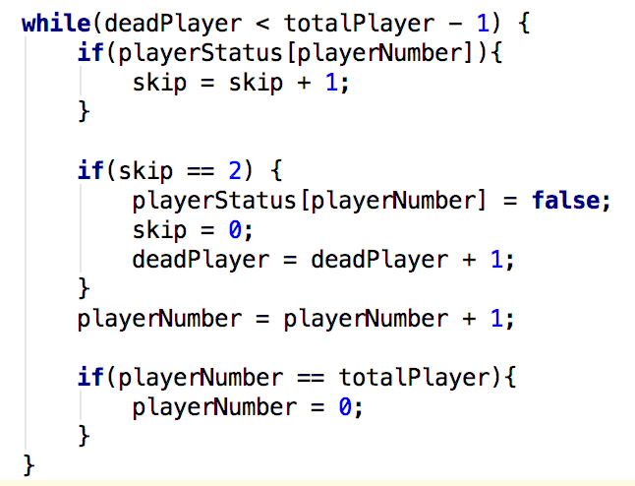
JosePhus Problem
Store the status of player (alive/dead) in a Boolean array
When the game starts, all players are alive
Always kill the second person => skip variable keeps track of who is the second player in all of the alive ones
Count the dead players
If one round ends, it starts from player 0

Slide 7
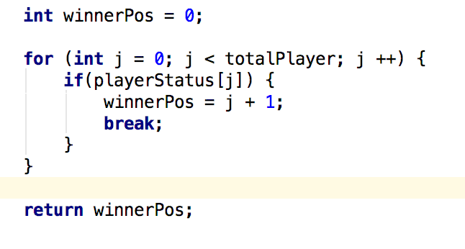
Check the position of the only alive player
Another solution: find the formula for Josephus problem (using binary code)

Slide 8
Thank you for your attention!

